Slide 1
Predicting COVID-19 Diagnosis
Nolan Arendt & Binosh Padman

Slide 2
INTRODUCTION
INTRODUCTION
COVID-19: A global challenge that has affected millions. Understanding the range of symptoms and their link to disease severity is crucial in optimizing treatment and timing of treatment. This analysis dives into symptom data to explore patterns and predict outcomes.

Slide 3
BUSINESS CASE
Develop a predictive model to determine the likelihood of a COVID-19 diagnosis based on reported symptoms and attributes.
Early identification of potential COVID-19 cases allow for timely interventions, reducing the spread and improving patient outcomes.
Without a predictive tool, reliance solely on testing can lead to delays and potential undetected cases, especially in asymptomatic individuals or those with mild cases.
A reliable predictive model can guide healthcare professionals in making informed decisions about testing, quarantine measures, and resource allocation, ultimately safeguarding public health.

Slide 4
WORKFLOW
01
04
02
05
03
Data Cleaning
Clustering Algorithms
Exploratory Data Analysis
Results & Future Analysis
Classification Algorithms

Slide 5
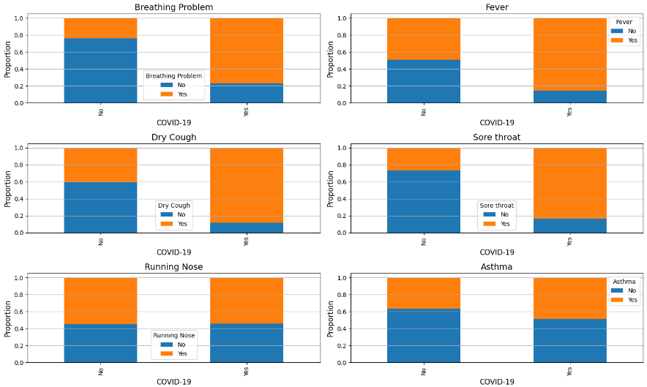
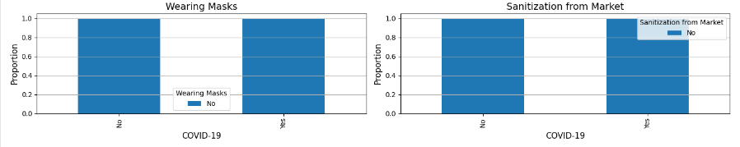
DATA DESCRIPTION
The dataset comprises responses from individuals regarding various symptoms, conditions, and behaviors related to COVID-19.
The dataset contains approximately 5434 samples and 21 features.
Symptoms include:
Breathing problems
Fever
Dry cough…
Behaviors include:
Abroad travel
Contact with COVID patient
Attended large gatherings…
Medical Conditions include:
Asthma
Chronic lung disease
Heart disease…

Slide 6
PREPROCESSING
Balancing of the data
Positive Cases: 4,383
Negative Cases: 1,051
Removing any rows with missing values.
Convert categorical variables (“Yes”, “No”) to numerical values (1, 0) for model compatibility.
Feature selection to identify the most informative features for the predictive model using correlation analysis,

Slide 7
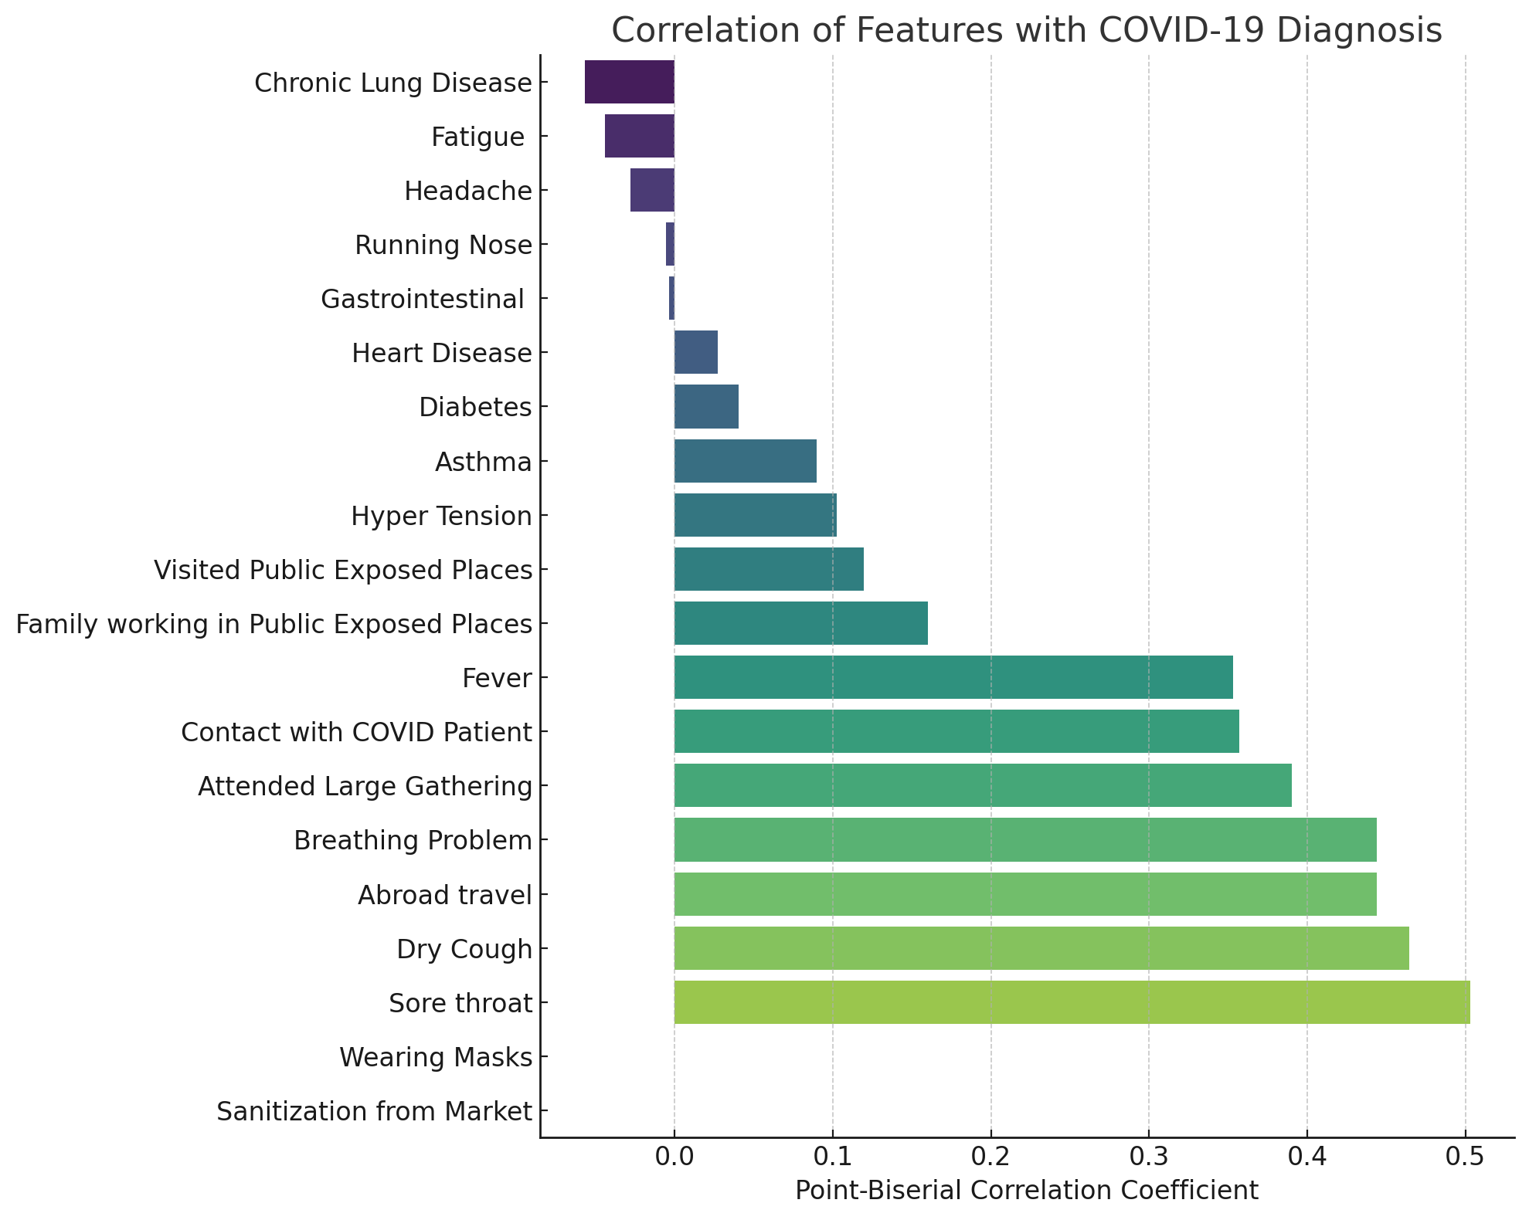
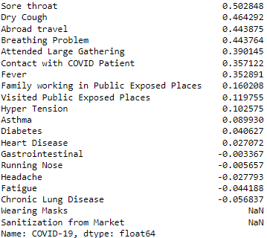
EXPLORATORY DATA ANALYSIS
Features ‘Contact with COVID Patient’, ‘Fever’ and ‘Dry Cough’ show strong positive correlation with a COVID-19 diagnosis.
Features ‘Wearing Masks’ and ‘Sanitization from Market’ had no value in the model and were thus excluded.
No feature exhibits a strong negative correlation with COVID-19 diagnosis. A strong negative correlation would imply the presence of the factor decreases the likelihood of a positive COVID-19 diagnosis.

Slide 8
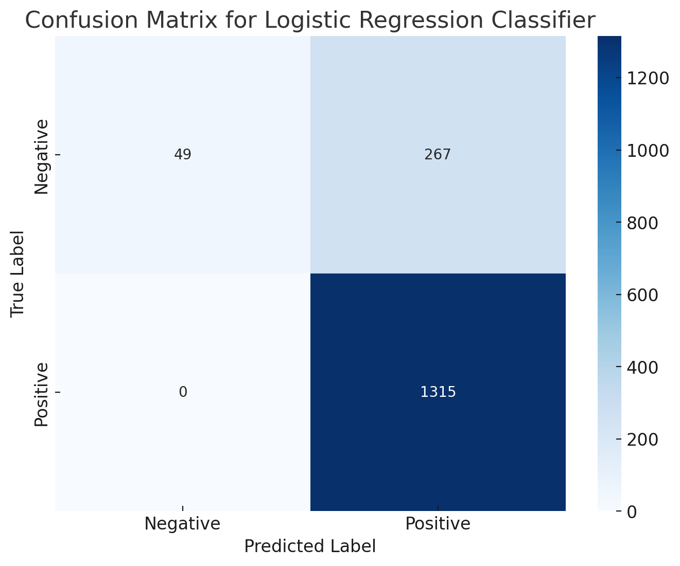
LOGISTIC REGRESSION CLASSIFICATION
The Logistic Regression classifier achieved an accuracy of approximately 82.94% on the testing set. The model was trained using balanced data with under-sampling, and specific hyperparameters were set to optimize the performance.
Parameters Used:
C = 0.0001
Penalty Type = L2
Fit Intercept = False
Solver = lbfgs
Maximum Iterations = 150
Class Weight = Balanced
Random State = 42
Notes:
Performance Overview: The confusion matrix provides insights into the classifier's correct and incorrect predictions, highlighting areas of strength and potential concern.
Critical Errors: The presence of false negatives indicates potential missed COVID-19 cases, while false positives suggest possible unnecessary interventions for healthy individuals.
Precision vs. Recall: Balancing precision (correct positive predictions) and recall (detection of actual positive cases) is essential, especially in medical contexts where both types of errors carry significant consequences.
Model Adjustments: The matrix can guide further refinements to the classifier, such as adjusting the threshold or retraining, to reduce specific types of errors based on healthcare priorities.

Slide 9
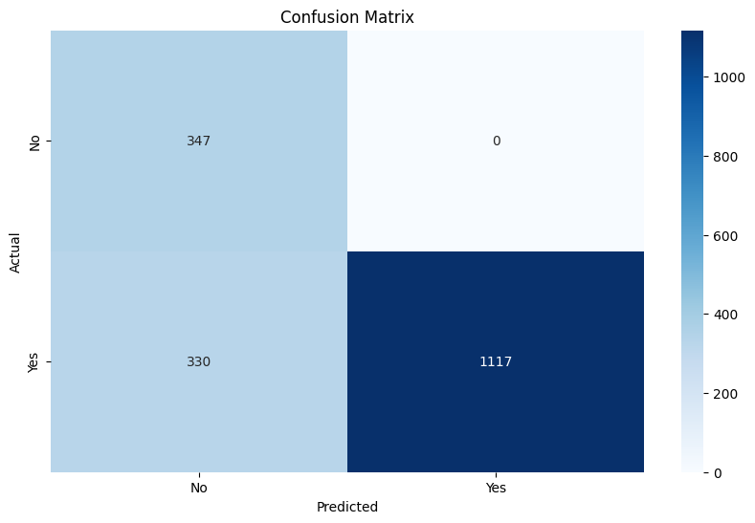
RANDOM FOREST CLASSIFICATION
The Random Forest classifier achieved an accuracy of approximately 81.83% on the testing set. The model was trained using balanced data with under-sampling, and specific hyperparameters were set to optimize the performance.
Parameters Used:
Random_state = 42
N_Estimators = 10
Max_Depth = 1
Min_Samples_Split = 3

Slide 10
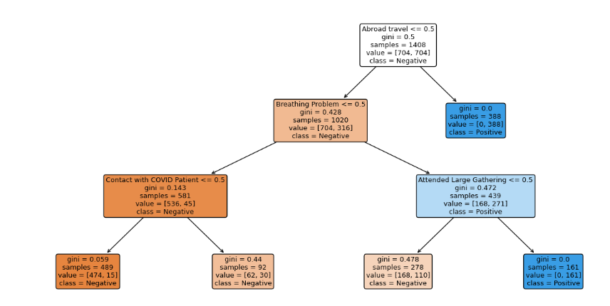
DECISION TREE CLASSIFICATION
The Decision Tree classifier achieved an accuracy of 81.61% on the testing set. The high accuracy suggests the model performed well in distinguishing between negative and positive cases of COVID-19.
The visualization of the tree helps provide insights into the decision-making process of this classifier.
Parameters Used:
Random_State = 42
Max_Depth = 3

Slide 11
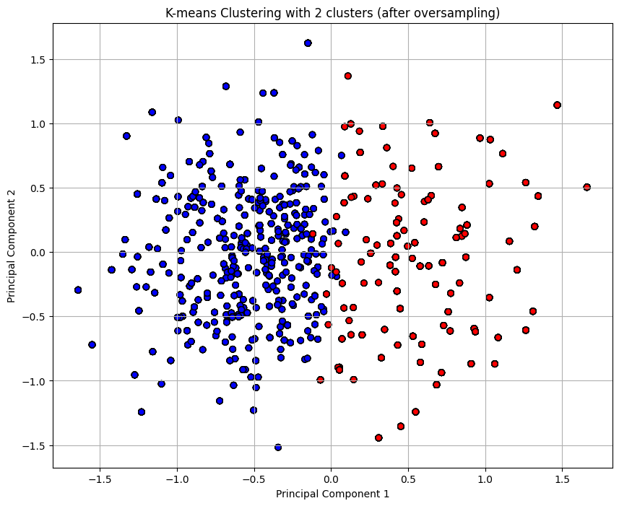
K-MEANS CLUSTERING
Using the elbow method, the optimal number of clusters was determined to be 2.
The K-Means clustering algorithm segmented the data into two groups, with the Silhouette Score of 0.0851 suggesting a moderate distinction between the clusters.

Slide 12
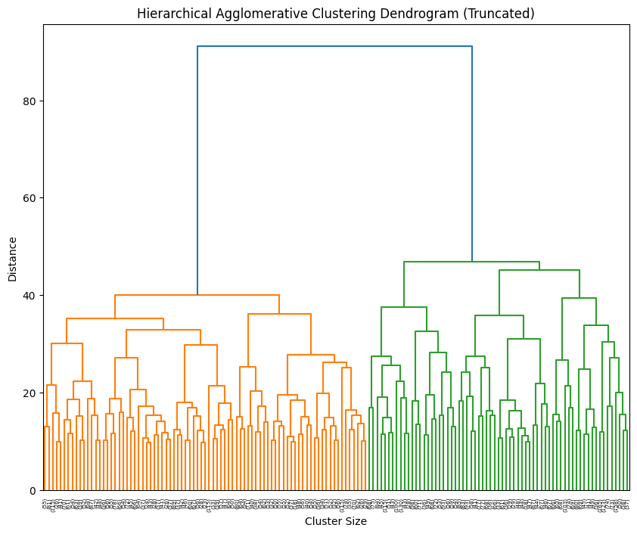
HAC CLUSTERING
Using the dendrogram, the optimal number of clusters was determined to be 2.
The HAC clustering algorithm segmented the data into two groups, with the Silhouette Score of 0.1664 suggesting a modest distinction between the clusters.
Cluster 0: 1018 of the data points
Cluster 1: 4416 of the data points

Slide 13
FINDINGS & CONCLUSION
Our Random Forest and Decision Tree classification algorithms both performed with relatively similar accuracy around ~81% in predicting if a patient has COVID-19. Linear Regression classifier performed slightly better with an 82% accuracy in predictions of our testing set.
High precision of both models indicates the model is very reliable when predicting positive cases, but not as accurate when predicting negative cases.
K-Means and HAC clustering algorithms had relatively good performance with regards to the silhouette score, but further refinement of the symptoms may increase the results.
Future steps would include gathering of more data, specifically at the location level to better understand how location has an impact. Also consider gathering data regarding ages, as our belief remains that COVID-19 impacted different age ranges at vastly different levels of significance.

Slide 14
QUESTIONS?
Nolan Arendt
Binosh Padman

